Slide 1
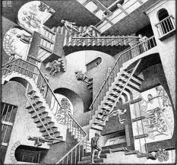
Differentiation Session 1 (Math as an example)
Michael Elder
#ncagt41 @ncagt
NCAGT Conference
www.academicinnovation.weebly.com
@meldernc

Slide 4
Blue Earth
Presenter Name
http://maccss.ncdpi.wikispaces.net/Summer+Institute+2012+6+-+12
By PresenterMedia.com

Slide 5
Ground Rules for a Differentiated Classroom
Gathered from gifted students who reported being in a differentiated classroom.
What would you hope for your child?
Mistakes are okay.
My classroom is a safe place to practice what I do not already know.
It is okay for me to do something different from my neighbor. (Medicine Example)
Where I begin does not determine where I end up.
My effort matters.
My teacher expects a lot from me.
My teacher is always here.
I get to learn about things that interest me (sometimes).

Slide 6
Let’s Practice
You are asked to prepare three friends to compete on Chopped. If any of them win they will split their $10,000 prize with you. The only catch is you cannot compete!
Friend One: Very creative, but is a very “Meat and Potatoes” kind of girl.
Friend Two: Loves to eat a variety of foods and has traveled extensively. However, one place she has not visited much is her own kitchen.
Friend Three: Owns a restaurant featured on Diners, Drive Ins and Dives.
Notes:
Each needs something different- first different content, second different processes, third knows the content and the processes may just need to be able to vary her product
All of them need time in the kitchen and all can probably use some of the same instruction
However, if they each get only the same instruction, they will not be likely to be successful

Slide 7
Do I have to?
This is generally considered to be conservative
In Reading

Slide 8
The Balance & The Goal(s)
Unique Abilities, Experiences, Needs, Learning Styles, Background Knowledge, Readiness, Interests, Social Dynamics
Master Same Concepts? Skills? Grow?

Slide 9
The How
Content
Process
Product
(Tomlinson)
Not all at once ☺

Slide 10
Pre-Assessment
Formal Classroom Measures
Informal (Formative) Measures
Informative
Benchmark Interim Summative Results
What are some types of pre-assessment?
How do we respond?
Who should be pre-assessed?
Notes:
Pre-assessment is key
Types of pre-assessment

Slide 11
Let’s Talk Tools
Differentiating by Content Q Taxons and Levels
www.quantiles.com
www.newsela.com

Slide 12
Grades 3-5
Quantile & Lexile Score Given for Each Child
http://www.ncpublicschools.org/docs/accountability/uisrs/eoguisr12.pdf

Slide 13
Most Difficult First
Share the most difficult task or problem(s)
Students who can demonstrate precision and accuracy do not need the additional practice

Slide 14
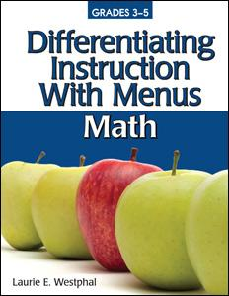
Choice and Menus
The Power of Choice
Choice:
Preferred Learning Styles of Gifted Kids
Choice only option that allows a teacher to meet a variety of student needs
Greater sense of independence
Increased Focus
Greater Completion Rates
Kids and People do not always know what they want
Also available for Language Arts, Science, Social Studies and for Inclusive Classrooms
https://www.ted.com/talks/malcolm_gladwell_on_spaghetti_sauce
Notes:
Video at 10:00 minutes to 12:30 ish- people do not know what they want

Slide 15
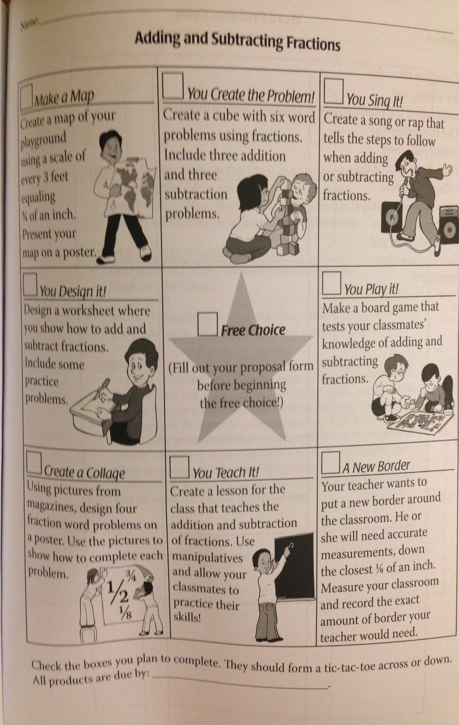
Tic-Tac-Toe Menu (Choice Menu One)
Characteristics
Eight Choices
One Free Space
Same Level of Bloom’s
Same Weight for Grading
Flexible
Can be limiting for students

Slide 16
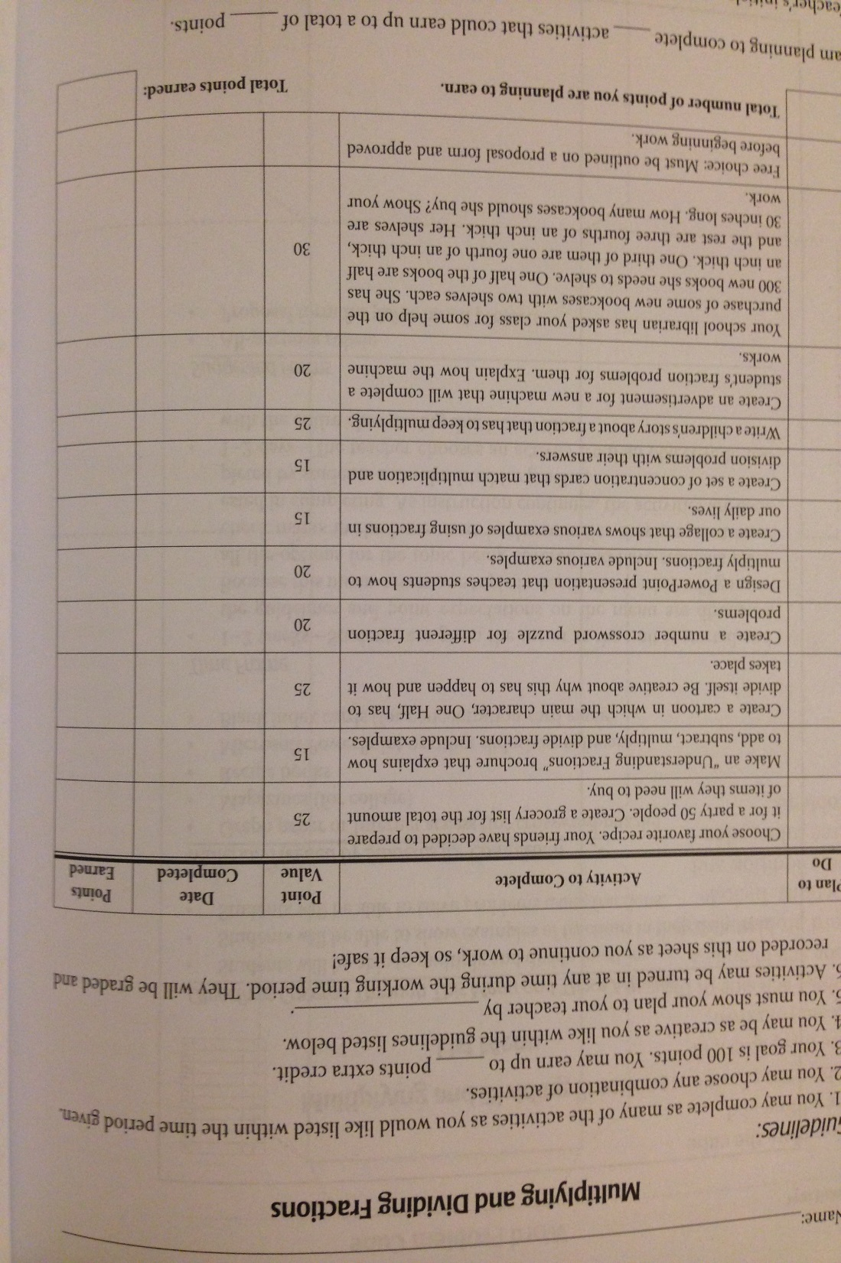
Check List (List Menu) (Choice Menu Two)
Characteristics
Challenge List
At least 10 Predetermined Choices
Weighted Scoring
Based on Bloom’s
Responsibility
Few Topics
No guarantees

Slide 17
2 -5 - 8 Menu (Choice Menu Three)
Characteristics
Two Choices (2 points)
Four Choices (5 points)
Two Choices (8 points)
Based on Bloom’s
Generally limited to one topic
Set Point Value/Target
Source: https://teacherleaders.wordpress.com/2014/06/28/standards-based-choice-assessment/

Slide 18
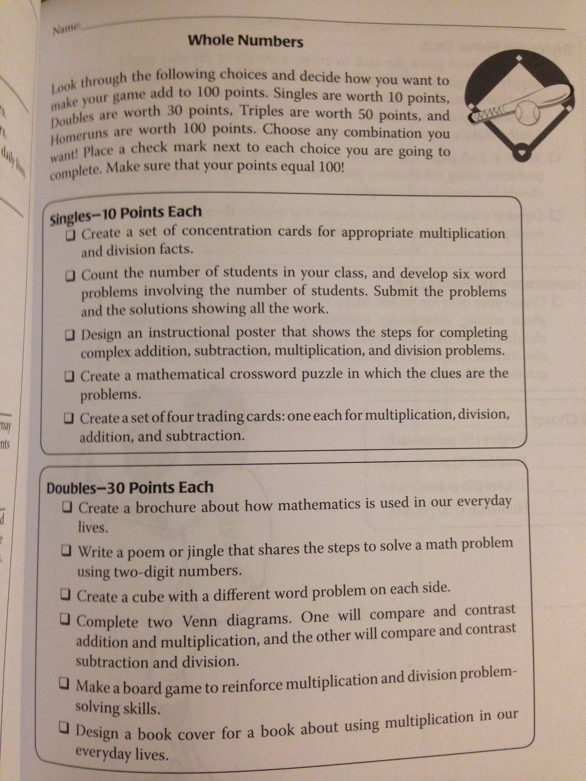
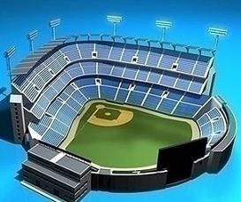
Baseball Menu (Choice Menu Four)
Characteristics
At Least 20 Choices
Singles (understand)
Doubles (apply and analyze)
Triples (evaluate)
Home Run (create)
Earn a certain number of runs for 100%

Slide 19
Math Success Mindset
Thinking first…Developing an “I can” mindset
Replace ‘buts’ with ‘and’ and move from complaints to solutions…
I’d like to do my homework, but I don’t have time.
I’d like to do my homework, and I don’t have time, so I will…
I’d like to do better in math, but I only like science more.
I’d like to do better in math, and I only like science, so I will…
I want to differentiate math, but…
I want to differentiate math, and… so I will…

Slide 20
Open Ended Questions
Number and Operations: K: What makes 5 a special number?; 2: A two-digit number has more tens than ones. What could the number be? How do you know your number is correct?
K-2 Geometry: Use any four tangram pieces to build a shape that looks like a house. Use geometry words to describe your house.
1-2 Measurement: How many baby steps are there in a giant step?; Describe 3 things that weigh less than a shoe. Tell how you know they weigh less than a shoe.
K-1 Algebra: Write three equations involving addition that are true and three that are not true.; Create two different stories that the equation 5 + = 9 could describe.
Credit to Marian Small (Great Ways to Differentiate Mathematics Instruction)

Slide 21
Parallel Tasks
Third Grade Data: The set of data below describes the ages of a group of people at a family party (32, 30, 5,2,1,62,58,28,26,25,24,2,4,39,16) Choice 1: Create a line plot to display the data Choice 2: Create a bar graph to display the data
Third-Fourth Grade Number and Operations Choice 1: Two fractions are equivalent. If you add the numerators, the result is 22 less than if you add the denominators. What could the fractions be Choice 2: Draw a picture to show equivalent fractions for 2/8.
Third-Fourth Grade Algebraic Thinking: Will Rebecca and Ethan ever have the same number of stickers? How many stickers would that be? Choice 1: Ethan has 30 stickers and Rebecca has 12. Ethan gives Rebecca 3 stickers at a time. Choice 2: Ethan has 50 stickers and Rebecca has 10. Ethan gives Rebecca 5 stickers at a time.
Credit to Marian Small (Great Ways to Differentiate Mathematics Instruction)

Slide 22
Other Content Differentiation Strategies
Tiered Activities
Open-ended activities
Higher level questions
Bloom’s Taxonomy
Curriculum Ladders
Students as Experts
Increase the complexity
Decrease the structure
List compiled by Tania Gonzalez, Onslow County Schools
Notes:
We will not have time to go into great depth with these today, but if you are interested in differentiating content, these are some other tools or methods

Slide 23
Change the Process Strategies
Pre-testing
Curriculum Compacting
Tiered Activities
Most Difficult First
Alternate Assignments
Learning Contracts
Independent Study
Learning Centres
Anchor Activities
Discovery Learning
List compiled by Tania Gonzalez, Onslow County Schools

Slide 24
Change the Product Strategies
Choice Boards
Tic tac toe menu
RAFT (Role, Audience, Format, Topic)
Game Show Menu
Student Choice option
Websites
Wikis
Podcasts
Movie Making
Game creation
List compiled by Tania Gonzalez, Onslow County Schools

Slide 25
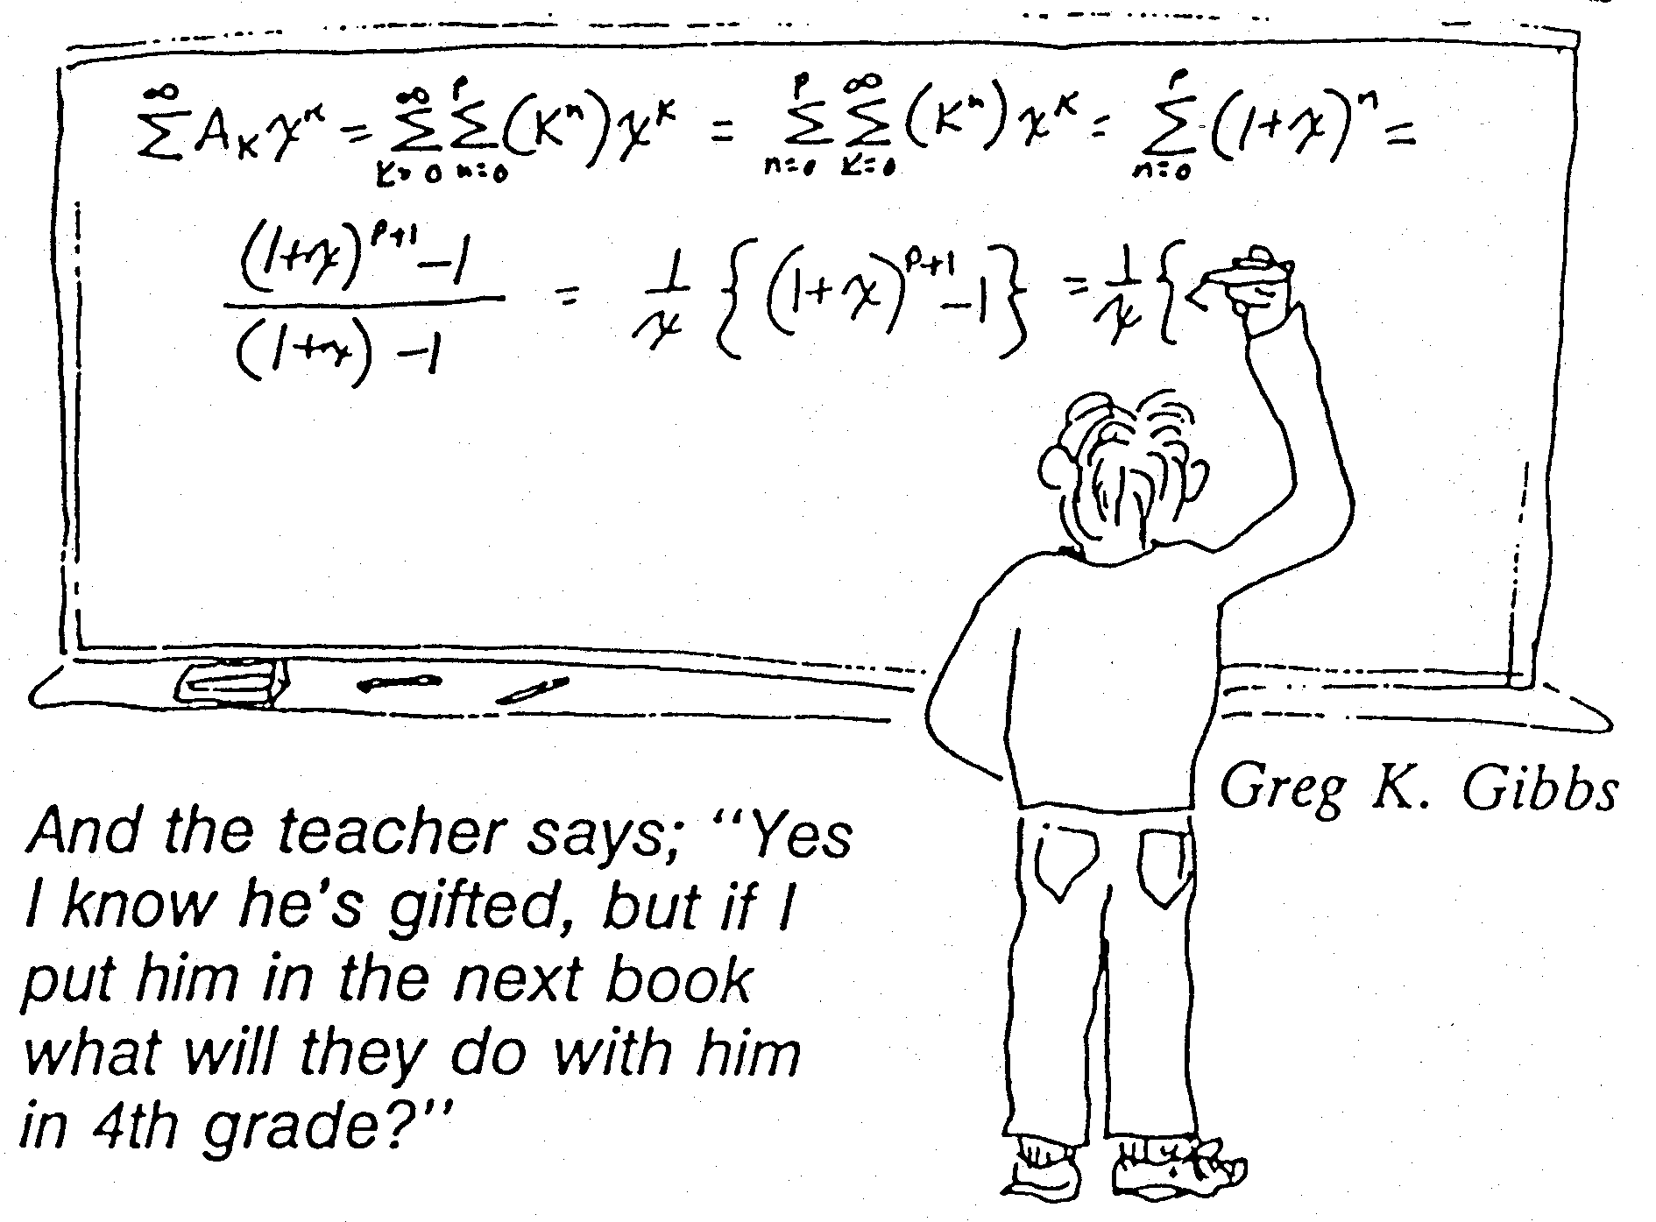
School Decisions

Slide 26
Pulling It All Together

Slide 27
Marian Small (2012): Good Questions: Great Ways to Differentiate Mathematics Instruction (Open Questions and Parallel Tasks)
Cathy Seeley (2009): Faster Isn’t Smarter (Messages about Math, Teaching, and Learning in the 21st Century)
Laurie E. Westphal (2007)
Differentiating Instruction With Menus: Math

Slide 28
On the Horizon
Differentiation is a mindset rather than a set of strategies.
We all need strategies, but at it’s heart, differentiation is considering that for some students their perspective is more like watching the Earth-rise rather than the sun-rise.

Slide 29
Digital Tools
Thanks to Shari Estep (Onslow County)
http://www.livebinders.com/play/play?id=1643410
Math Playground (especially Thinking Blocks)
http://www.mathplayground.com/thinkingblocks.html
Quantiles (shared earlier)
https://quantiles.com/tools/quantile-teacher-assistant/
Gifted Links Compiled Symbaloos
http://onslowaig.weebly.com/gifted-links-symbaloo.html
Today’s Presentation and Past Presentations:
http://onslowaig.weebly.com/gifted-conference-presentations.html

Slide 30
Thank You

